Slide 1
Supportive Care
Ongoing Assessment
- Infant, Interface, CPAP Machine
Feeding Considerations
Notes:
In this webinar we could learn the supportive care of a newborn on CPAP
Supportive care of a newborn on CPPA includes Ongoing assessment of the newborn, nasal interface and The CPAP machine, ensuring early and aggressive enteral feeding

Slide 2
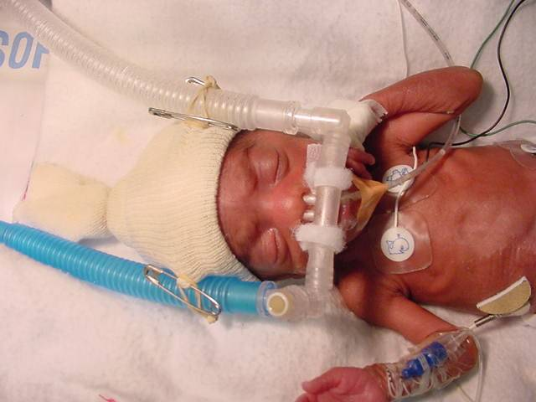
Ongoing Assessment
CPAP
SYSTEM
INFANT
INTERFACE
Complete assessment: 4-6 hr
Vital signs: 2-3 hr
Notes:
Assessment is ongoing, systematic, thorough and meticulous
Vitals need to be assessed every 2 to 3 hours and complete assessment of infant, interface and CPAP system should be done every shift or every 4 to 6 hours

Slide 3
A. Infant Monitoring
Appearance: Comfort, color, posture
Vitals : Temp, HR, RR, SPO2, BP
CVS: Pulse volume, CRT, U/o, BP
CNS: Activity, tone, responsiveness
GIT: OGT, abdominal distension
Settings: FiO2, CPAP and Flow
Notes:
Infant monitoring should include vitals, assessment of all the organ settings. Also one need to assess the adequacy of FiO2, CPAP and flow in each shift

Slide 4
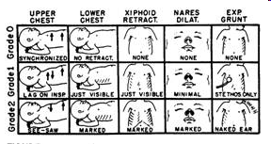
Respiratory Monitoring
Clinical
- RR, Effort, Pattern
- Chest Movement
- Retractions
- Grunt
- Breath sounds
- Air entry
SILVERMAN SCORE
Notes:
Respiratory monitoring should include assessment of respiratory rate, recessions, chest movements, breath sounds and bubble sounds. An objective assessment of Silverman anderson score is also essential atleast twice in each shift.

Slide 5
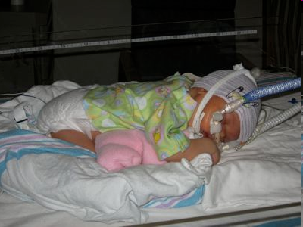
Optimal Positioning
Reposition q 3 to 6 hr
Nesting
- Promote flexion, containment and comfort
Notes:
Infants in any position need to be properly supported by rolls. Repositioning should be done every 3 to 6 hour. Promote nesting and avoid excess flexion, extension, rotation of the head and neck.

Slide 6
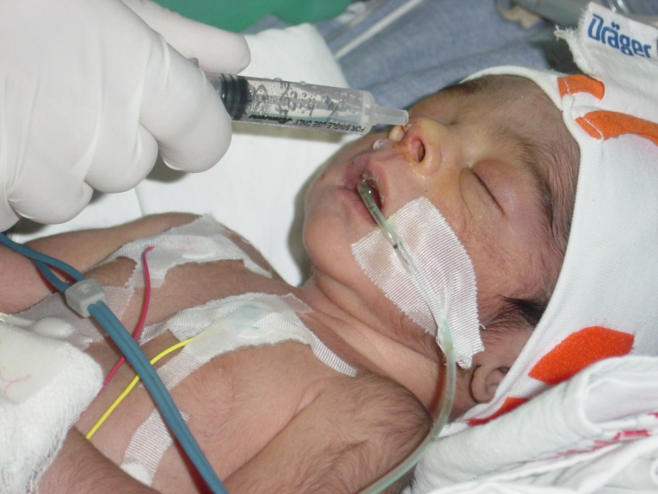
Airway Monitoring
Note the color, consistency, & quantity of nasal secretions
Suction the mouth, nose and pharynx
Moisten the nares with normal saline or sterile water
Notes:
Airway monitoring includes assessment of secretions in the nose and mouth. Suctioning is recommended only when required. When the secretions are thick moisten the nares with normal saline or sterile water.

Slide 7
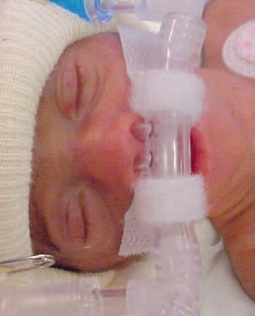
B. Interface
  Prongs should fit snuggly
  Symmetry of Nares?
  Blanching of skin at nares?
  Skin breakdown?
  Gap between columella and Prongs
Notes:
Ensure the prongs are fit snuggly into the nares. Watch for symmetry of nose, blanching of the skin and any skin break down. Ensure distance between columella and Nasal prongs

Slide 8
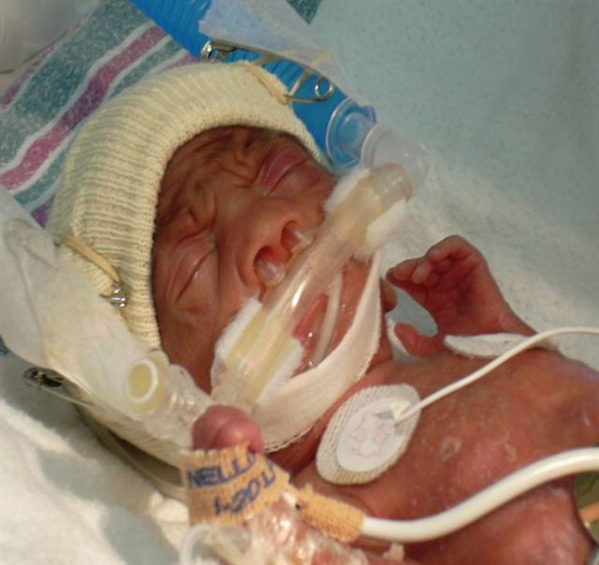
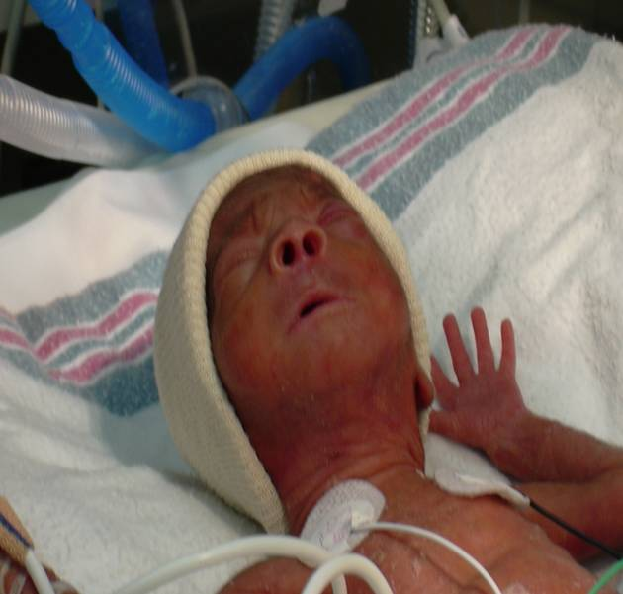
Assessing the nasal interface
Is the cap appropriately
placed?
Is the nasal interface
component twisted?
Compress the tip of the
nose
Notes:
The cap should cover the ears and fit snugly. Watch for twisting of the nasal interface if any? Blanch the tip of nose and assess for perfusion integrity.

Slide 9
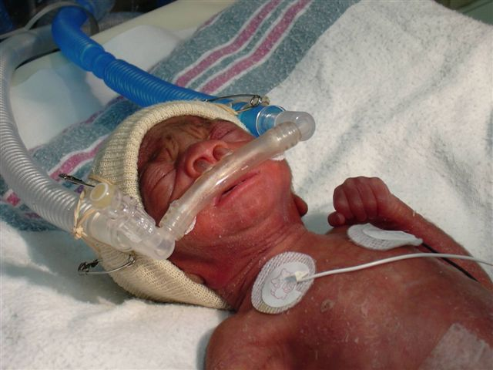
Assessing Skin integrity
Color
Quality of perfusion
Possible areas of
pressure or
excoriation
Notes:
Watch for color, perfusion, areas of pressure points and areas of skin excoriations.

Slide 10
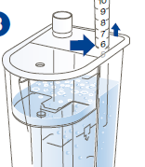
C. Monitoring CPAP System
CPAP pressure?
FIO2 reading?
Flow rate?
Is there bubbling?
Water level …cm
Notes:
Monitoring of the CPAP system includes recording the CPPA Pressure, FiO2 and flow rate. Bubble chamber should be monitored for bubbling and the level of water..

Slide 11
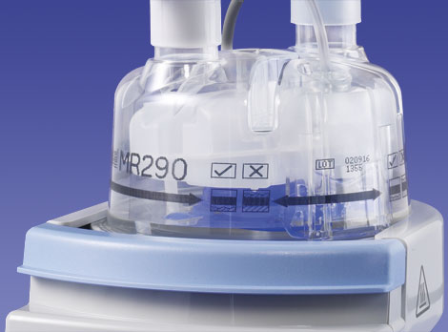
HUMIDIFICATION
Set the humidifier in invasive mode
Water level correct
No condensation in inspiratory limb
Condensation in expiratory limb
Notes:
Invasive mode, set temperature of 37C on the humidifier, adequate water in the chamber, no condensation in the inspiratory limb and some condensation in the expiratory limb are proof of good and adequate humidification

Slide 12
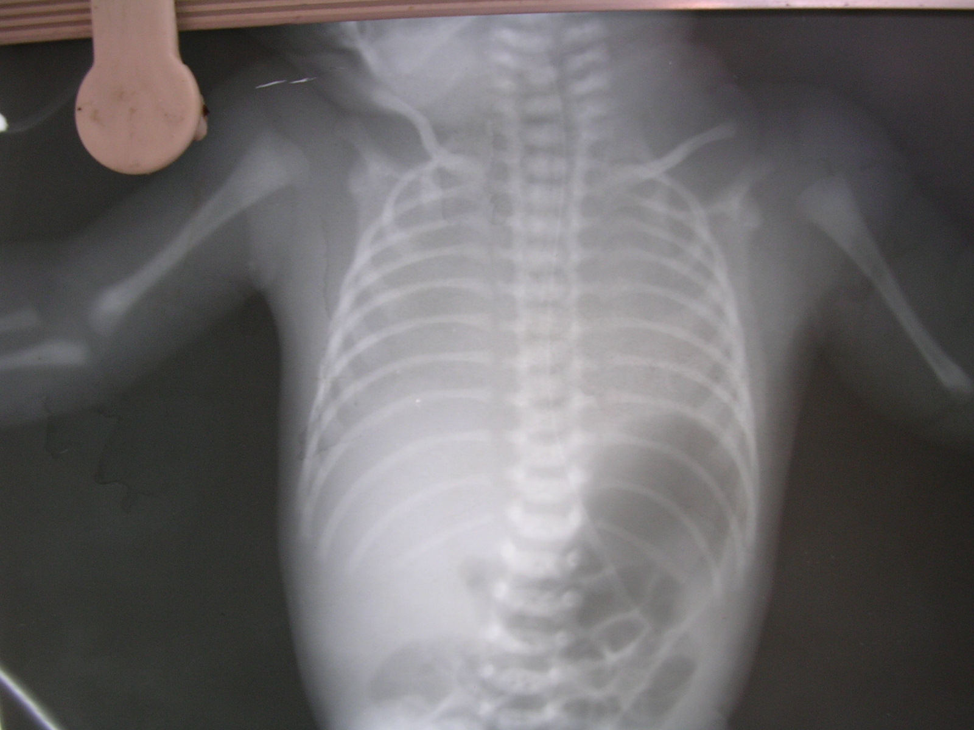
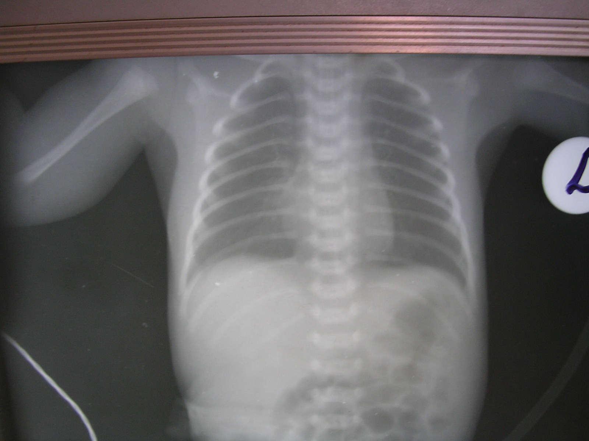
Radiologic Monitoring
Notes:
Radiological monitoring is required at starting of CPAP and during any acute deterioration.

Slide 13
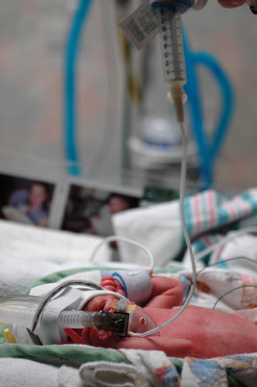
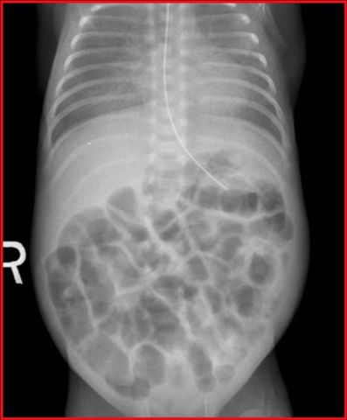
Feeding Considerations
Notes:
All newborns on CPAP should be fed provided there is no obvious contraindicaiton such as NEC or hemodynamic instability. To prevent CPAP belly as shown in the figure ensure insertion of a OG tube immediately of initiating CPAP and keeping the OG tube above the level of stomach and keeping it open.

Slide 14
Summary
Monitoring of
  Infant, Interface and CPAP System
Respiratory monitoring
Feeding Consideration
Notes:
Monitoring of the infants, Interface and CPAP system are essential components of Monitoring of a newborn on CPAP
Respiratory monitoring is needed to assess efficacy of CPAP and also for early identification of possible complications
Feeding a newborn on CPAP with Orogastric tube and prevention of CPAP belly improve the overall success of CPAP

